Slide 1
CST 205 OOP :INTRODUCTION TO JAVA PROGRAMMING

Slide 2
OBJECTIVES
Introduction to Java - Java programming Environment and Runtime Environment, Development
Platforms -Standard, Enterprise. Java Virtual Machine (JVM), Java compiler, Bytecode,
Java applet, Java Buzzwords, Java program structure, Comments, Garbage Collection, Lexical Issues.

Slide 3
OBJECTIVES
INTRODUCTION TO JAVA
OVERVIEW OF JDK,JRE AND JVM
JAVA PLATFORMS
JAVA BUZZWORDS
JAVA APPLET
JAVA PROGRAM STRUCTURE
GARBAGE COLLECTION IN JAVA
JAVA LEXICAL ISSUES

Slide 4
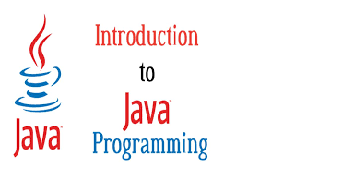
INTRODUCTION TO JAVA
Java was designed by Sun Microsystems in the early 1990s to solve the problem of connecting many household machines together.
In 1991 java was started initially it was called as “Oak”.
Later Java became popular for developing web internet applications.
Java was developed by James Gosling and a small team of engineers.

Slide 5
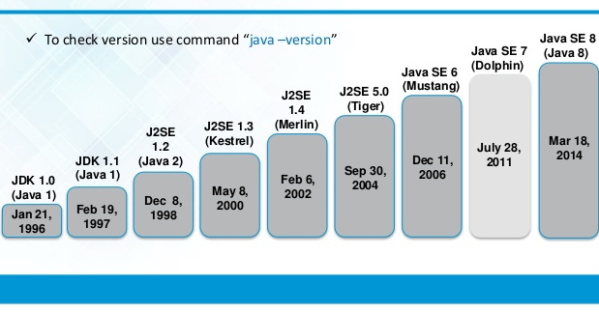
Java Version History
JDK Alpha and Beta (1995)
JDK 1.0 (23rd Jan 1996)
JDK 1.1 (19th Feb 1997)
J2SE 1.2 (8th Dec 1998)
J2SE 1.3 (8th May 2000)
J2SE 1.4 (6th Feb 2002)
J2SE 5.0 (30th Sep 2004)
Java SE 6 (11th Dec 2006)
Java SE 7 (28th July 2011)
Java SE 8 (18th Mar 2014)
Java SE 9 (21st Sep 2017)
Java SE 10 (20th Mar 2018)
Java Platform, Standard Edition 17
Java SE 18.0.2.1 is the latest release of Java SE Platform.

Slide 6
Java programming Environment and Runtime Environment
JAVA DEVELOPMENT KIT
The Java Development Kit (JDK) is a software development environment which is used to develop Java applications and applets.
JDK – Java Development Kit (in short JDK) is Kit which provides the environment to develop and execute(run) the Java program. JDK is a kit(or package) which includes two things
Development Tools(to provide an environment to develop your java programs)
JRE (to execute your java program).

Slide 7
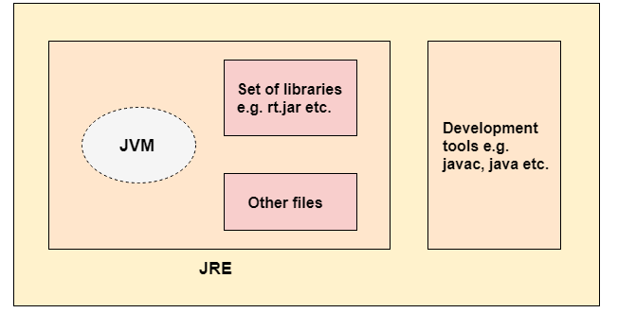
JAVA DEVELOPMENT KIT

Slide 8
JAVA DEVELOPMENT KIT (JDK)
The Java Development Kit (JDK) is a software development environment used for developing and executing Java applications and applets.
It includes the Java Runtime Environment (JRE), an interpreter/loader (Java), a compiler (javac), an archiver (jar), a documentation generator (Javadoc) and other tools needed in Java development.
JDK is only used by Java Developers.

Slide 9
Java Runtime Environment (JRE)
JRE is also called as Java runtime, is a part of JDK.
It pprovides minimum requirements for executing java application.
It contains the class libraries, loader class, and JVM.
If you want to run Java program you need JRE.
All JDK versions comes bundled with Java Runtime Environment, so you do not need to download and install the JRE separately in your PC.
The runtime environment loads class files and ensures there is access to memory and other system resources to run them.
JRE is an installation package which provides environment to only run(not develop) the java program(or application)onto your machine.

Slide 10


JDK AND JRE

Slide 11
Java Virtual Machine (JVM)
JVM (Java Virtual Machine) is an abstract machine that enables your computer to run a Java program.
JVM is a program which provides the runtime environment to execute Java programs.
JVM is a virtual machine that resides in the real machine (your computer) and the machine language for JVM is byte code.
Java compiler first compiles your Java code to bytecode.
Then, the JVM translates bytecode into native machine code (set of instructions that a computer's CPU executes directly).

Slide 12
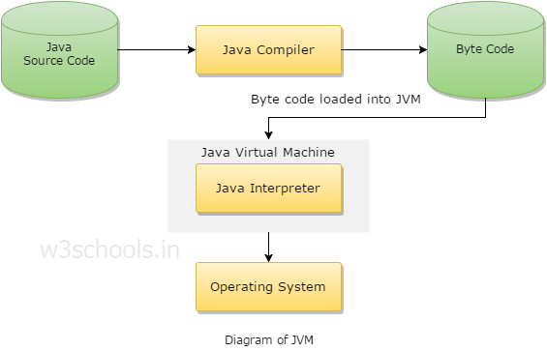
Java Virtual Machine (JVM)

Slide 13
Java Bytecode
Java bytecode is the instruction set for the Java Virtual Machine.
Bytecode is the compiled format for Java programs.
When we write a program in Java, firstly, the compiler compiles that program and a bytecode is generated for that piece of code.
When a Java program is compiled, a Bytecode is generated for that program in the form of a .class file.
The bytecode generated after the compilation is run by the Java virtual machine.
Resources required to run the bytecode are made available by theJava Virtual Machine, which calls the processor to allocate the required resources.

Slide 14
Java Bytecode
Java byte code is the instruction set for the Java Virtual Machine.
It is the machine code in the form of a .class file.
Byte code is a machine independent code.
It is not completely a compiled code but it is an intermediate code somewhere in the middle which is later interpreted and executed by JVM.
Byte code is a machine code for JVM.
Byte code implementation makes Java a platform- Independent
language.

Slide 15
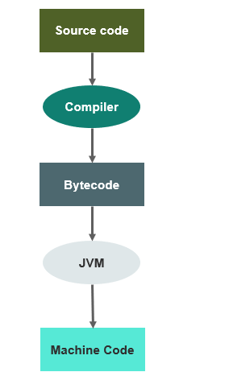
Java Bytecode

Slide 16
Advantages of Java Bytecode
Platform independence is one of the soul reasons for which James Gosling started the formation of java and it is this implementation of bytecode which helps us to achieve this.
When a program is written and compiled in JAVA a separate file is created for a compiled program. This file (.class) is called bytecode in java.\
Byte code generated in a particular platform can be executed in any other platform i.e. the byte code generated in windows OS can also be executed in Unix OS.
The one which makes this possible is the JVM (JAVA VIRTUAL MACHINE).
When the program is written and compiled the compiler send the generated bytecodes to the JVM in the machine and this JVM converts the byte codes into native code which is readable by a particular machine. Thus the output is displayed.

Slide 17
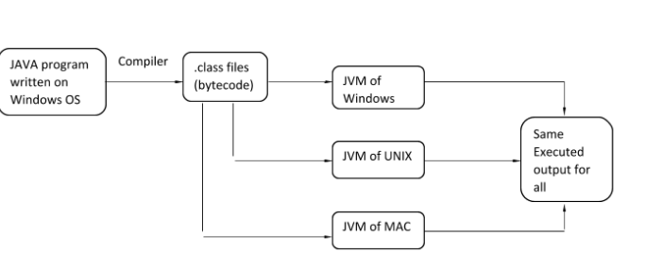
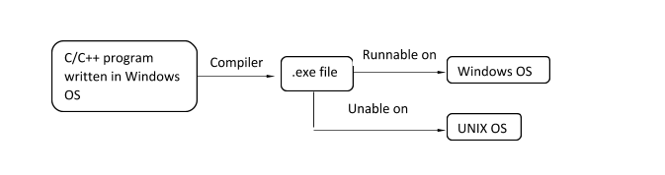
Advantages of Java Bytecode

Slide 18
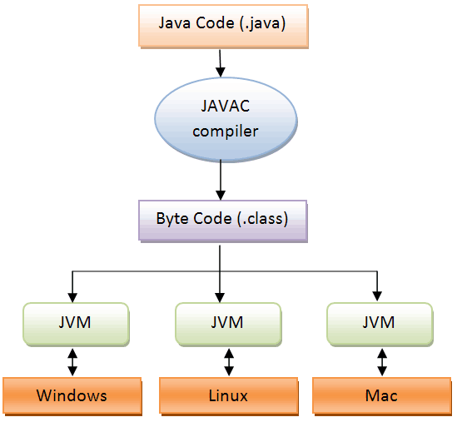
Advantages of Java Bytecode

Slide 19
JAVA COMPILER
Java is compiled language. But it is very different from traditional compiling in the way that after compilation source code is converted to byte code.
Javac is the most popular Java compiler.
javac is the primary Java compiler included in the Java Development Kit (JDK) from Oracle Corporation.
The compiler accepts source code conforming to the Java language specification (JLS) and produces Java bytecode
When you write a program code, verification of method signatures and other variables is performed at compile-time. In general, a compiler converts the source code to target code.

Slide 20
JVM Architecture Diagram
The classloader subsystem is an essential core of the Java Virtual machine and is used for loading/reading the .class files and saving the bytecode in the JVM method area.
The JVM is divided into three main subsystems:
ClassLoader Subsystem
Runtime Data Area
Execution Engine
ClassLoader Subsystem
The classloader subsystem is an essential core of the Java Virtual machine and is used for loading/reading the .class files and saving the bytecode in the JVM method area. This component performs the linking of a class or an interface.
Initialization: This component performs the final phase of the class loading where all the static variables are assigned the original values and the static blocks are executed from the parent to the child class.

Slide 21
JVM Architecture Diagram
The classloader subsystem is an essential core of the Java Virtual machine and is used for loading/reading the .class files and saving the bytecode in the JVM method area.
2. Memory Areas Allocated By the JVM:
Class(Method) Area
Heap
Stack
Program Counter Register
Native Method Stack
Method Area: This component holds the class level data of each .class file such as metadata, constant runtime pool, static variables, the code for the methods etc.
Heap The Heap area is the memory block where objects are created or objects are stored.
Stack Area: This component is again a part of JVM memory where all the temporary variables are stored.
PC (Program Counter) Registers: This component holds the address of the JVM instruction which is currently executing.

Slide 22
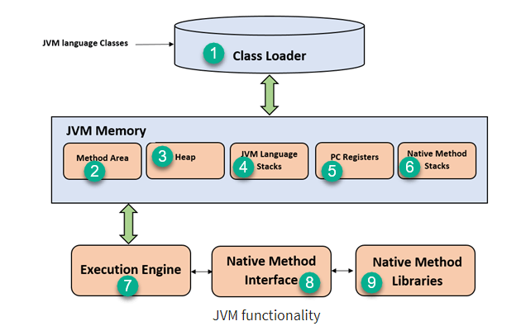
JVM Architecture Diagram
3.Execution Engine
The bytecode, which is assigned to the Runtime Data Area, will be executed by the Execution Engine.
The Execution Engine reads the bytecode and executes it piece by piece, it consists of Interpreter, JIT Compiler and Garbage collector.

Slide 23
JVM Architecture Diagram
Interpreter – Interpreter is basically a translator which converts Java Bytecodes into machine code (the actual code understandable to computer known as binary code). it translate bytecodes line by line.
The interpreter interprets the bytecode faster but executes slowly.
The disadvantage of the interpreter is that when one method is called multiple times, every time a new interpretation is required.
JIT Compiler –
The JIT Compiler neutralizes the disadvantage of the interpreter.
The Execution Engine will be using the help of the interpreter in converting byte code, but when it finds repeated code it uses the JIT compiler, which compiles the entire bytecode and changes it to native code.
This native code will be used directly for repeated method calls, which improve the performance of the system.

Slide 24
Identify the difference between JDK,JRE AND JVM??

Slide 25
The Java Programming Language Platforms
There are four platforms of the Java programming language:
Java Platform, Standard Edition (Java SE)
Java Platform, Enterprise Edition (Java EE)
Java Platform, Micro Edition (Java ME)
JavaFX
All Java platforms consist of a Java Virtual Machine (JVM) and an application programming interface (API).

Slide 26
The Java Programming Language Platforms
Java SE[Java Standard Edition]
When most people think of the Java programming language, they think of the Java SE API.
Java SE's API provides the core functionality of the Java programming language.
It defines everything from the basic types and objects of the Java programming language to high-level classes that are used for networking, security, database access, graphical user interface (GUI) development, and XML parsing.
In addition to the core API, the Java SE platform consists of a virtual machine, development tools, deployment technologies, and other class libraries and toolkits commonly used in Java technology applications.

Slide 27
The Java Programming Language Platforms
Java EE [Java Enterprise Edition]
The Java EE platform is built on top of the Java SE platform. The Java EE platform provides an API and runtime environment for developing and running large-scale applications..
The Java EE provides a platform for developers with enterprise features such as distributed computing and web services, Enterprise JavaBeans, Java Server Pages, Servlets.
Examples of some contexts where Java EE is used are e-commerce, accounting, banking information systems.

Slide 28
The Java Programming Language Platforms
Java EE [Java Micro Edition]
The Java ME platform provides an API and a small-footprint virtual machine for running Java programming language applications on small devices, like mobile phones.
The API is a subset of the Java SE API, along with special class libraries useful for small device application development.
Java ME applications are often clients of Java EE platform services.

Slide 29
The Java Programming Language Platforms
JavaFX
JavaFX is a software platform for creating and delivering desktop applications, as well as rich Internet applications (RIAs) that can run across a wide variety of devices.
The applications built in JavaFX, can run on multiple platforms including Web, Mobile and Desktops.
JavaFX is intended to replace swing in Java applications as a GUI framework.
JavaFX is a set of graphics and media packages that enables developers to design, create, test, debug, and deploy rich client applications that operate consistently across diverse platforms.

Slide 30
JAVA APPLET
An applet is a Java program that can be embedded into a web page. It runs inside the web browser and works at client side.
An applet is a special kind of Java program that runs in a Java enabled browser.
This is the first Java program that can run over the network using the browser.
To create an applet, a class must class extends java.applet.Applet class.
An Applet class does not have any main() method.
It is viewed using JVM. The JVM can use either a plug-in of the Web browser or a separate runtime environment to run an applet application.
Note: Java Applet is deprecated since Java 9. It means Applet API is no longer considered important.

Slide 31
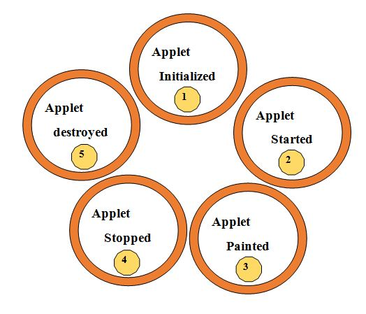
JAVA APPLET
Lifecycle of Java Applet
Applet is initialized.
Applet is started
Applet is painted.
Applet is stopped.
Applet is destroyed.

Slide 32
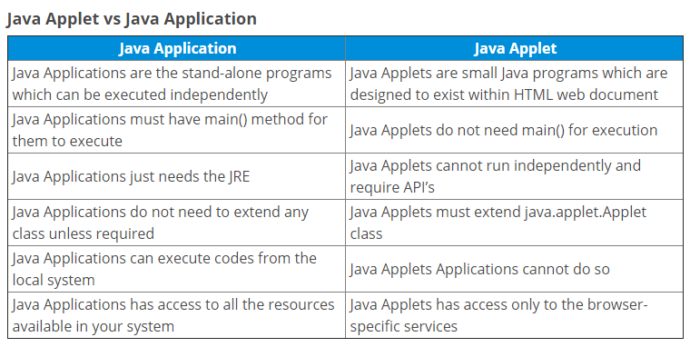
JAVA APPLET

Slide 33
Java Buzzwords
Simple
Secure
Portable
Object-oriented
Robust
Multithreaded
Architecture-neutral
Interpreted
High performance
Distributed
Dynamic

Slide 34
Java Buzzwords
1.Simple
Java was designed to be easy for the professional programmer to learn and use effectively.
If you already understand the basic concepts of object-oriented programming, learning Java will be even easier.
C++ programmer can move to JAVA with very little effort to learn.
Java syntax is based on C++
Java has removed many complicated and rarely-used features, for
example, explicit pointers, operator overloading, etc.

Slide 35
Java Buzzwords
2. Object-Oriented
Java strongly supports the concepts of Object-Oriented Programming .
Java supports major Object-Oriented programming features like Encapsulation, Abstraction, and Inheritance.
Almost everything in Java is an object. All programs and data live within objects and classes.
‘Objects’ model Java rather than the ‘processes’.

Slide 36
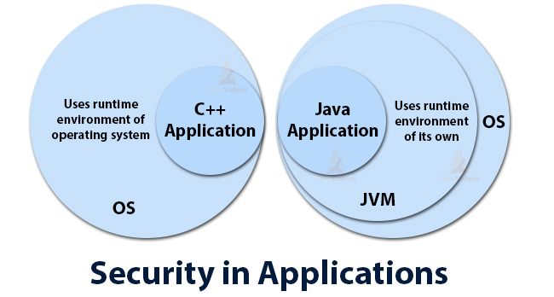
Java Buzzwords
3.Secure
When a Java Compatible Web browser is used, downloading can be done safely without fear of viral infection or malicious intent.
Java is a more secure language as compared to C/C++, as it does not allow a programmer to explicitly create pointers.
Programs run in a virtual machine sandbox – A separate environment that allows users to execute their applications without affecting the underlying system.

Slide 37
Java Buzzwords
3.Secure
It has a bytecode verifier that checks the code fragments for any illegal code that violates the access right.
Has secure class loading and verification mechanism ensures that only legitimate Java code is executed.
Java uses its own internal memory and data management systems to block any unauthorized data access.
Java has an error checker built into the compiler.
Java compiler also suggests changes to the program that will rid it of errors and improve its authenticity. The developer can then choose to apply these suggestions or not.
Java has a garbage collection mechanism that automatically frees up memory.
Developers can keep their data safe with Java’s private and specific keywords.
.

Slide 38
Java Buzzwords
What makes java more secure than other languages?
Doesn’t use pointers as other languages do
Automated memory management
The Java compiler check, detects and handles errors seamlessly.
Java Sandbox
Security API’s
Exception Handling
Foolproof data type checking

Slide 39
Java Buzzwords
4.Robust :Robustness is the capacity of a computer system to handle the errors during execution and manage the incorrect input of data.
Java is robust because it utilizes strong memory management.
Java is a strictly typed language, it checks your code at compile time. However, it also checks your code at run time .
Two of the main reasons for program failure: memory management mistakes and mishandled exceptional conditions (that is,run-time errors).
Java virtually eliminates these problems by managing memory allocation and deallocation for you.Deallocation is completely automatic, because Java provides garbage collection for unused objects.
Java provides object-oriented exception handling. In a well-written Java program, all run-time errors can—and should—be managed by your program.
Hence java is robust.

Slide 40
Java Buzzwords
5.Multithreaded
Multithreaded means handling multiple tasks simultaneously or executing multiple portions (functions) of the same program in parallel.
The code of java is divided into smaller parts and Java executes them in a sequential and timely manner.
6.Architecture-Neutral
This buzzword means that the program written on one platform or OS is independent of other platforms or environments and can run on any other Operating System without recompiling them. In other words, it is based on the ‘Write-once-run-anywhere’ (WORA) or ‘Write-once-run-everywhere’ (WORE) approach.
Byte-code is not dependent on any machine architecture and Java Virtual Machine (JVM) can easily translate bytecode into a machine-specific code.

Slide 41
Java Buzzwords
7.Interpreted and Compiled
The bytecode can either be interpreted or compiled to native code or directly executed on the processor. But, if the bytecode is interpreted, it directly affects the speed of the application.
In order to speed up the performance, JIT( Just in Time Compiler ) compiler communicates with JVM at the execution time in order to compile byte code sequences into native machine code.
Basically, when using JIT Compiler, the native code is easily executed by the hardware when compared to JVM Interpreter. By doing so, there will be a huge gain in execution speed.
8. Portable
Java programs can execute in any environment (Linux,Window,Mac etc.) for which there is a Java run-time system (JVM).
That really means there is no implementation dependent features.

Slide 42
Java Buzzwords
9. Platform Independent
Being platform-independent means a program compiled on one machine can be executed on any machine in the world without any change. Java achieves platform independence by using the concept of the BYTE code.
Java compiler converts the source code into an intermediate code called the byte code and this byte code is further translated to machine-dependent form by another layer of software called JVM (Java Virtual Machine).
Therefore, JVM can execute bytecode on any platform or OS .
This is where the “Write Once, run anywhere” (WORA) slogan for Java comes in, which means that we can develop applications on one environment (OS) and run on any other environment without doing any modification in the code.

Slide 43
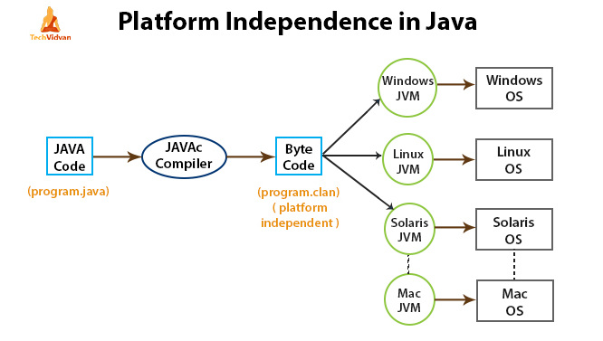
Java Buzzwords
9. Platform Independent

Slide 44
Java Buzzwords
10. Distributed
Java is distributed because it encourages users to create distributed applications.
In Java, we can split a program into many parts and store these parts on different computers. A Java programmer sitting on a machine can access another program running on the other machine.
Java helps us to achieve this by providing the concept of RMI (Remote Method Invocation) and EJB (Enterprise JavaBeans).
Java comes with an extensive library of classes for interacting, using TCP/IP protocols such as HTTP and FTP, which makes creating network connections much easier than in C/C++.
It also enables multiple programmers at many locations to work together on a single project.

Slide 45
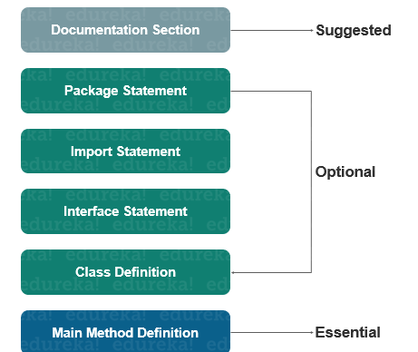
JAVA PROGRAM STRUCTURE

Slide 46
JAVA PROGRAM STRUCTURE
Documentation Section
You can write a comment in this section. It helps to understand the code. These are optional.
It is used to improve the readability of the program.
The compiler ignores these comments during the time of execution
Types of comments that Java supports
➢Single line Comment
//This is single line comment
➢Multi-line Comment
/* this is multiline comment.
and support multiple lines*/

Slide 47
JAVA PROGRAM STRUCTURE
Package Statement
A package is a group of classes that are defined by a name.
That is, if you want to declare many classes within one element, then you can declare it within a package
Package is declared as: package packagename;
Eg: package mypackage;
Import Statement
If you want to use a class of another package, then you can do this by importing it directly into your program.
import java.util.Date; //imports the date class

Slide 48
JAVA PROGRAM STRUCTURE
Class Definition
A Java program may contain several class definitions. Classes are the main and essential elements of any Java program.
Main Method Class
The main method is from where the execution actually starts .
Every Java stand-alone program requires the main method as the starting point of the program.
This is an essential part of a Java program.
There may be many classes in a Java program, and only one class defines the main method.
Methods contain data type declaration and executable statements.

Slide 49
A First Simple Program
/*
This is a simple Java program.
Call this file "Example.java".
*/
public class Example
{
// Your program begins with a call to main().
public static void main(String args[])
{
System.out.println("This is a simple Java program.");
}
}

Slide 50
Here are the most important points to note about the Java programs:
You have to keep in mind that, Java code is case sensitive.
To write a Java program, you must have to define class first.
The name of the class in Java (which holds the main method) is the name of the Java program, and the same name will be given in the filename.
As mentioned above in the sample program;
The name of the class is " Example " in which the main method is, then this file will be named " Example.Java".

Slide 51
Here are the most important points to note about the Java programs:
public class Example | This creates a class called Example . The public word means that it is accessible from any other classes.
/* Comments */ | The compiler ignores comment block. Comment can be used anywhere in the program to add info about the program or code block, which will be helpful for developers to understand the existing code in the future easily.
Braces | Two curly brackets {...} are used to group all the commands, so it is known that the commands belong to that class or method.

Slide 52
Here are the most important points to note about the Java programs:
public static void main | When the main method is declared public, it means that it can also be used by code outside of its class, due to which the main method is declared public. The word static used when we want to access a method without creating its object. The word void indicates that a method does not return a value. main() is declared as void because it does not return a value. main is a method; this is a starting point of a Java program.
String[] args | It is an array where each element of it is a string, which has been named as "args". If your Java program is run through the console, you can pass the input parameter, and main() method takes it as input.
System.out.println(); | This statement is used to print text on the screen as output, where the system is a predefined class, and out is an object of the PrintWriter class defined in the system. The method println prints the text on the screen with a new line. You can also use print() method instead of println() method.

Slide 53
Garbage Collection in Java
When JVM starts up, it creates a heap area which is known as runtime data area. This is where all the objects (instances of class) are stored.
Since this area is limited, it is required to manage this area efficiently by removing the objects that are no longer in use.
The process of removing unused objects from heap memory is known as Garbage collection and this is a part of memory management in Java.
Languages like C/C++ don’t support automatic garbage collection, however in java, the garbage collection is automatic.
In java, garbage means unreferenced objects.
Garbage Collection is process of reclaiming the runtime unused memory automatically. In other words, it is a way to destroy the unused objects.

Slide 54
Garbage Collection in Java
Main objective of Garbage Collector is to free heap memory by destroying unreachable objects.
Unreachable objects : An object is said to be unreachable if it doesn’t contain any reference to it.
Eligibility for garbage collection : An object is said to be eligible for GC(garbage collection) if it is unreachable.
finalize() method – This method is invoked each time before the object is garbage collected and it perform cleanup processing.

Slide 55
Garbage Collection in Java
Basic process.
In the first step, unreferenced objects are identified and marked as ready for garbage collection.
In the second step, marked objects are deleted.
Optionally, memory can be compacted after the garbage collector deletes objects, so remaining objects are in a contiguous block at the start of the heap.
The compaction process makes it easier to allocate memory to new objects sequentially after the block of memory allocated to existing objects.

Slide 56
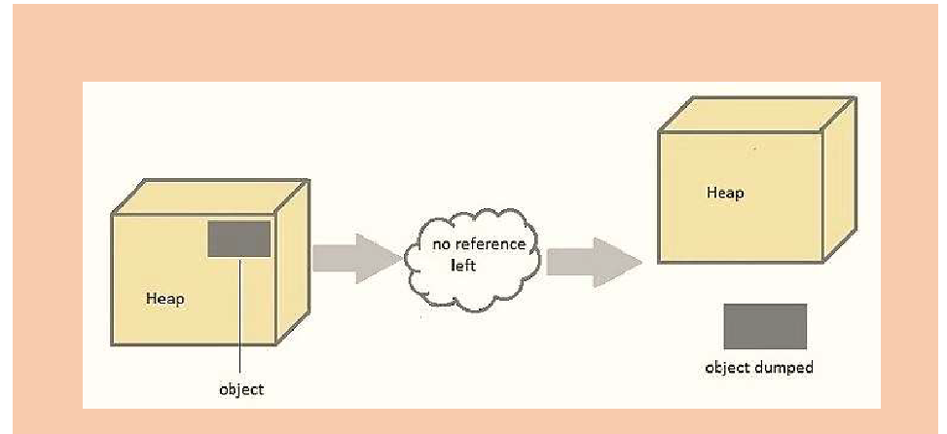
Garbage Collection in Java

Slide 57
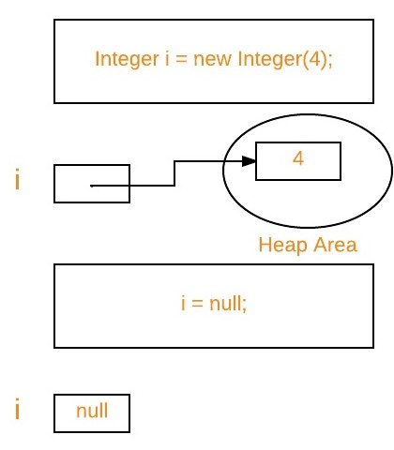
Garbage Collection in Java

Slide 58
Garbage Collection in Java
Request for Garbage Collection
The garbage collection implementation lives in the JVM.
We now know that the unreachable and unusable objects are available for garbage collection but the garbage collection process doesn’t happen instantly.
Which means once the objects are ready for garbage collection they must to have to wait for JVM to run the memory clean-up program that performs garbage collection.
We can request to JVM for garbage collection by calling System.gc() method.

Slide 59
Garbage Collection in Java
Advantage of Garbage Collection
It makes java memory efficient because garbage collector removes the unreferenced objects from heap memory.
It is automatically done by the garbage collector(a part of JVM) so we don't need to make extra efforts.

Slide 60
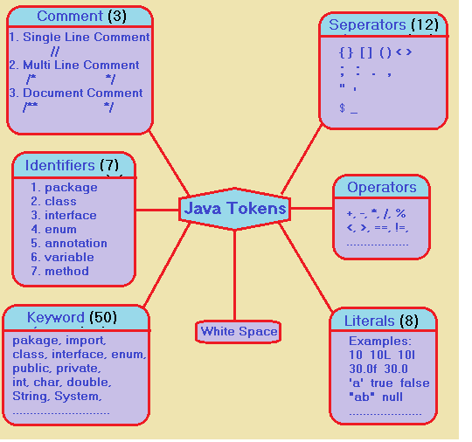
Lexical issues in Java (Java Tokens)
Java Tokens are the smallest individual building block or smallest unit of a Java program.
Java program is a collection of different types of tokens.

Slide 61
Lexical issues
Whitespace
Java is a free-form language. This means that you do not need to follow any special indentation rules.
There should be at least one whitespace character between each token that was not already delineated by an operator or separator.
In Java, whitespace is a space, tab, or newline.
White space in Java is used to separate tokens in the source file. It is also used to improve readability of the source code.
Eg: int i = 0;

Slide 62
Lexical issues
Identifiers
Java Identifiers are the user-defined names of variables, methods, classes, arrays, packages, and interfaces.
An identifier may be any descriptive sequence of uppercase and lowercase letters, numbers, or the underscore and dollar-sign characters.
They must not begin with a number.
Again, Java is case-sensitive, so VALUE is a different identifier than Value.
Some examples of valid identifiers are
AvgTemp, count, a4..

Slide 63
Lexical issues
Identifiers
Identifier must follow some rules.
All identifiers must start with either a letter( a to z or A to Z ) or currency
character($) or an underscore.
They must not begin with a digit.
After the first character, an identifier can have any combination of characters.
A Java keywords cannot be used as an identifier.
Identifiers in Java are case sensitive, foo and Foo are two different
identifiers.
They can be any length Eg: int a; char name;

Slide 64
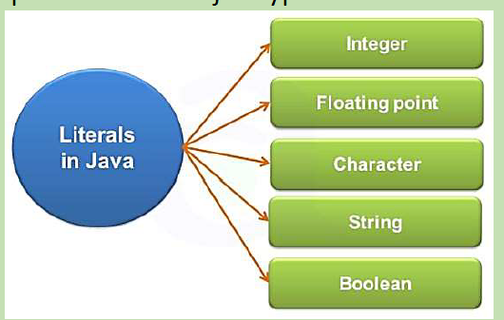
Lexical issues
Constants or Literals
Literals or Constants are fixed values of a particular type of data, which cannot be modified in a program.
Literals are constant variables with fixed values.
For example, here are some literals:
Eg int num = 100;
float num = 88.9;
char example = ‘c’
String str = “hai”
boolean b = false;

Slide 65
Lexical issues
Comments
As mentioned, there are three types of comments defined by Java. You have already seen two: single-line and multiline.
The third type is called a documentation comment. This type of comment
is used to produce an HTML file that documents your program.
The documentation comment begins with a /** and ends with a */.
Separators
In Java, there are a few characters that are used as separators. The most commonly used separator in Java is the semicolon.

Slide 66
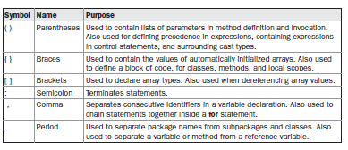
Lexical issues
Separators

Slide 67
Lexical issues
The Java Keywords
Keywords in Java are predefined or reserved words that have special meaning to the Java compiler.
Each keyword is assigned a special task or function and cannot be changed by the user.
These keywords, combined with the syntax of the operators and separators, form the foundation of the Java language.
These keywords cannot be used as names for a variable, class, or method.
The keywords const and goto are reserved but not used.
In addition to the keywords, Java reserves the following: true, false, and null. These are values defined by Java.
You may not use these words for the names of variables, classes, and so on.

Slide 68
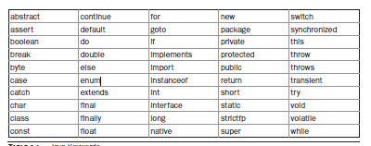
Lexical issues
The Java Keywords

Slide 69
Lexical issues
Operators
An operator is a symbol that takes one or more arguments and operates on them to produce a result.
• Unary Operator
• Arithmetic Operator
• shift Operator
• Relational Operator
• Bitwise Operator
• Logical Operator
• Ternary Operator
• Assignment Operator

Slide 70
SUMMARY
JAVA is an object-oriented language similar to C++, but with advanced and simplified features.This language is free to access and can run on all platforms.
Java is: –
Concurrent where you can execute many statements instead of sequentially executing it.
Class-based and an object-oriented programming language.
Independent programming language that follows the logic of “Write once, Run anywhere” i.e. the compiled code can run on all platforms which supports java.

Slide 71
Thanks!
Any questions?

